Slide 1
GO Team Meeting #1

Slide 2
TOPICS
School Strategic Plan
Strategic Plan & Priorities Review
SMART Goals
Data Discussion
Spring MAP Data
GMAS
School Uniform Discussion
Principal’s Report
Current Enrollment & Leveling
Information about our school

Slide 3
2021-2025 Strategic Plan

Slide 4
Mary Lin Elementary School
Mission: Our vision is to foster students who are lifelong, proactive learners. Our students will be clear communicators who use innovative problem-solving to address the complex issues facing our community and world.
Vision: The mission of Mary Lin Elementary is to educate our students through meaningful, interdisciplinary experiences. Partnerships among students, teachers, and the community will prepare our students to be caring and creative risk-takers ready for the world.
SMART Goals
Percentage of students in grades 3-5 scoring proficient in ELA on GMAS will increase by 1% each year through 2025. Currently, MLE has 89% proficient in ELA.
Percentage of students in grades 3-5 scoring proficient in Math on GMAS will increase by 2% each year through 2025. Currently, MLE has 76% proficient in Math
Show overall growth, as determined by the State of Georgia, for at least 75% of the population in both ELA and Math on GMAS and MAP.
Increase the achievement for all lower performing subgroups within the school as measured by GMAS.
APS Strategic Priorities & Initiatives
School Strategic Priorities
School Strategies
Fostering Academic Excellence for All Data
Curriculum & Instruction Signature Program
1. Use data to inform instruction.
2. Adhere to the scope and sequence of the Georgia Standard of Excellence and supplement with other resources.
1. Hold monthly data digs led by administration.
2. Weekly lesson planning and internalization led by instructional coaches.
Created a new Equity, Diversity, and Inclusion Committee on MLE PTA.
Provide equity and anti-bias training for all staff members.
Engage students in weekly STEAM activities, Science Fair, Science Night, Spelling Bee, Math Family Night, Inclusive School’s Week, No Place for Hate Week, Red Ribbon Week, Black History Celebration, Girls on the Run, LEEP aftershool activities, and Helen Ruffin Reaching Bowl.
Administer BASC to screen for students who need additional support. Implement small group and individual couseling sessions. Dedicate 15 protected minutes for Morning Meeting and Second Step lessons that focus on social and emotional growth.
Create collaborative school culture that embraces diverse families that comprise MLE community.
Build teacher capability to meet the diverse social, emotional and academic needs of students.
Provide unique learning opportunities to cultivate students’ curiosity of learning.
Prioritize students’ social and emotional growth as a means of ensuring future success.
Building a Culture of Student Support
Whole Child & Intervention Personalized Learning
Equipping & Empowering Leaders & Staff
Strategic Staff Support Equitable Resource Allocation
Equitably align school resources with MLE mission and vision.
Mary Lin Foundation grants must be screened and approved.
Additional support staff hired (nurse, hourly intervention teachers, full-time substitutes, etc.
Provide professional learning opportunities to empower and equip teachers to work with diverse population.
Creating a System of School Support
Strategic Staff Support
Equitable Resource Allocation
Provide an environment that retains, empowers, motivates and inspires teachers to utilize their individual strengths.
System of accountability for school-based leaders.
Leadership and professional learning opportunities for all staff members based on strengths.
14

Slide 5
Strategic Plan
Priority Ranking
Insert the school’s priorities from Higher to Lower
Higher
Use data to inform instruction.
Create collaborative school culture that embraces diverse families that comprise MLE community.
Prioritize students’ social and emotional growth as a means to ensuring future success.
Build teacher capability to meet the diverse social, emotional and academic needs of students.
Equitably align school resources with MLE mission and vision.
Provide an environment that retains, empowers, motivates and inspires teachers to utilize their individual strengths.
Lower

Slide 6
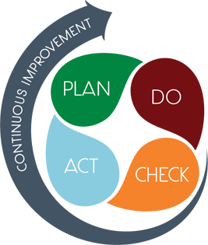
Connecting the Strategic plan & Continuous Improvement Plan
Use data to inform instruction
By May 2025, the percentage of students in grades 3-5 scoring a 3 or above on the GMAS EOG ELA writing domain trait 1 will grow 6% from 59% to 65% and the percentage of students in grade 3 scoring a 2 or above on the GMAS EOG ELA writing domain trait 2 will grow 8% from 72% to 80%.
EOG Scores (Achievement & Growth)
Strategic Plan Priority
CIP SMART Goal
Key Indicator
Create collaborative school culture that embraces diverse families that comprise MLE community
CIP SMART GOAL
KEY INDICATOR
Prioritize students’ social and emotional growth as a means to ensuring future success.
By May 2025, students in grades 2-5 will have set MAP Growth Goals in each content area (math & reading) before each assessment period (Winter & Spring administration).
MAP Growth Data (Achievement & Growth)

Slide 7
Connecting the Strategic plan & Continuous Improvement Plan
Build teacher capability to meet the diverse social, emotional and academic needs of students.
CIP SMART GOAL
KEY INDICATOR
Strategic Plan Priority
CIP SMART Goal
Key Indicator
Equitably align school resources with MLE mission and vision.
CIP SMART GOAL
KEY INDICATOR
Provide an environment that retains, empowers, motivates and inspires teachers to utilize their individual strengths.
CIP SMART GOAL
KEY INDICATOR

Slide 8
Data Discussion

Slide 9
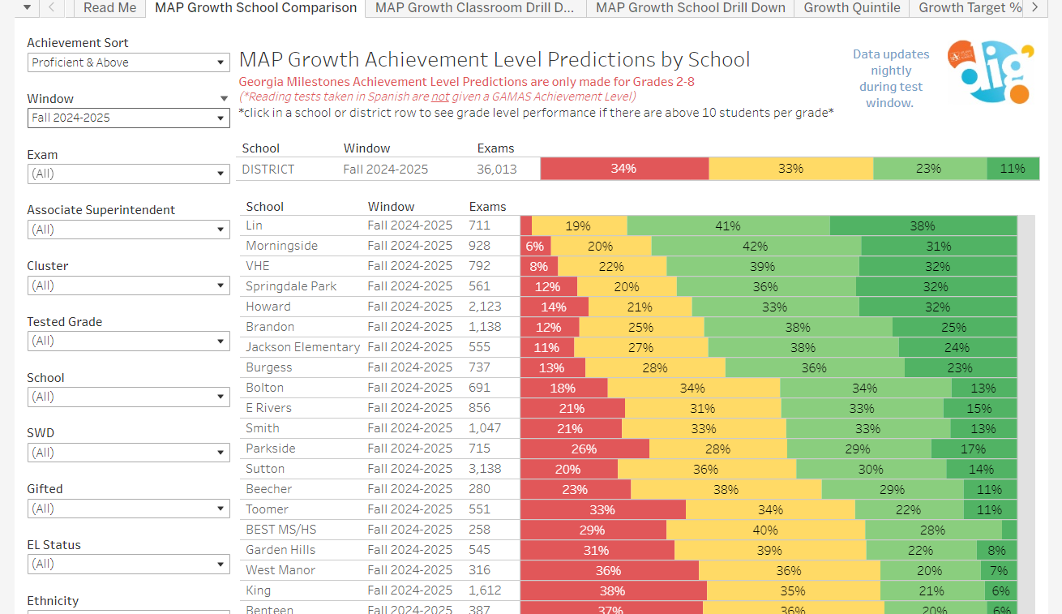
Spring MAP Results

Slide 10
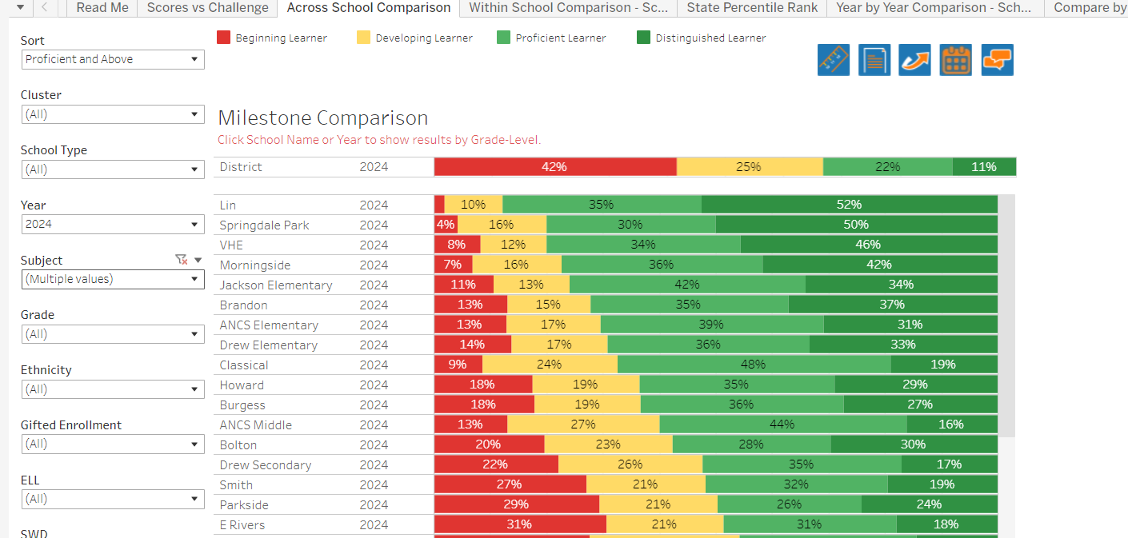
GMAS Results
Milestones Math results are embargoed by GA DOE until late September 27, 2024.

Slide 11
Glows & Grows
Glows
Grows
are we on target to successfully ACCOMPLISH our priorities?
IMPACT

Slide 12
GO Team Discussion: Data Protocol
What do you notice?
What are your wonderings?
What additional questions do you have?

Slide 13
Timeline for GO Teams
You are HERE
Fall 2021
GO Team Developed 2021-2025 Strategic Plan
1
Summer
School Leadership completed Needs Assessment and defined overarching needs
2
August
School Leadership completed Continuous Improvement Plan
3
Sept. – Dec.
Utilizing current data, the GO Team will review & possibly update the school strategic priorities and plan
4
Before Winter Break
GO Team will take action (vote) on the rank of the strategic plan priorities for SY25-26 in preparation for budget discussions.
5

Slide 14
Questions?

Slide 15
Discussion: Optional School Uniform

Slide 16
Optional School Uniform
In the 2023-2024 school year, the APS Board of Education updated the district’s dress code policy. As part of the update, starting with the 2025-2026 school year if a school wishes to maintain or explore implementing an optional school uniform, it must go through an engagement process and have a vote as outlined below:
Elementary
Middle
High
A school uniform is adopted upon the agreement of the principal and a majority vote of the School Governance Team (GO Team).
School uniforms are adopted upon the agreement of the principal, GO Team and the elected student government. If the school does not have an elected student government, then a majority vote must be secured from the student body to adopt a school uniform.
School uniforms are adopted upon the agreement of the principal, GO Team and the elected student government. If the school does not have an elected student government, then a majority vote must be secured from the student body to adopt a school uniform.
If your school currently has a school uniform and wishes to continue it, you must go through this process!

Slide 17
ABOE Policy JCDB Student Dress Code (Last Revised, 06/03/2024)
http://tinyAPS.com/?APSDressCodePolicy
Requirements
Restrictions
A top of non-see through fabric
A bottom of non-see through fabric
Shoes
Undergarments that are not visible
No words or symbols that are gang-related, sexually suggestive, obscene or promote illegal behavior
Nothing associated with alcohol, illegal drugs or tobacco
No flip-flops, athletic slides or footwear that doesn’t support the front and back of the foot

Slide 18
School-specific Dress Codes
We have one districtwide student dress code adopted
by the Atlanta Board of Education.
School-specific dress codes may not contradict Board policy.
Examples of problematic school specific dress-code provisions
“dress in good taste”
“no baggy pants”
“no short shorts or skirts”
“no tight/revealing clothing”
“no ‘extreme’ hairstyles or colors”
“all shirts must be tucked in
“hair should be clean and neatly groomed”
“no shirts which expose cleavage”
“students dressed in uniform are better perceived by teachers and peers”
“no activewear”
“no sweatpants”
“no spaghetti straps”
“no tube tops”
“no dresses”
“no leggings”
“no joggers”
“no Crocs”
“no hoodies/hooded jackets”

Slide 19
School Uniforms
Schools may choose to adopt an optional school uniform.
Effective immediately, at no time will students have their instructional time interrupted or be barred from school or class for declining to wear the optional school uniform.

Slide 20
Establish an optional school uniform
If your school currently has a school uniform and wishes to continue it, you must go through this process!
The GO Team needs to TAKE ACTION (vote) on maintaining or exploring implementing an optional school uniform.
After the motion and a second, the GO Team may have additional discussion. Once discussion is concluded, the GO Team will vote.
If the GO Team votes to move forward, then the team should proceed to discuss the School Uniform Advisory Committee.
Take Action

Slide 21
DISCUSSION
Only needed if the GO Team voted YES to maintaining or exploring establishing an optional school uniform.
The GO Team will now discuss if they wish to move forward with establishing a School Uniform Advisory Committee.
The School Uniform Advisory Committee will be responsible for:
Develop a stakeholder engagement plan to receive feedback on implementing a uniform and its components, if adopted. Must include a minimum 20-day public comment period on any proposed uniform
Recommending the optional school uniform components.
Establishing the student voting timeline and process (if necessary).
Determine the length of time the uniform will be in use before reconsideration
Developing a communication plan to inform the school community about the optional school uniform, if the uniform is adopted
Other objectives as defined by the GO Team.

Slide 22
Committee members
Only needed if the GO Team voted YES to maintaining or exploring establishing an optional school uniform.
The GO Team will also need to determine who will be on the committee:
The GO Team Chair will name the Committee Chair.
No more than 2 additional GO Team members may be on the committee (a maximum of 3 GO Team Members).
Committee must have at least 3 students as outlined below:
Other committee members may be added, as determined by the GO Team.
Elementary
Middle
High
Elementary School with Ambassadors Recommend inclusion of at least 3 student ambassadors
Elementary School without Ambassadors
Recommend inclusion of at least 3 students selected by the principal with GO Team input
Middle School with Student Ambassadors
At least 3 student ambassadors
Middle School without Student Ambassadors
At least 3 students selected by the principal with GO Team input
High School with Elected Student Government
At least 3 students as selected by the SGA
High School without Elected Student Government
At least 3 students as selected by the principal with GO Team input

Slide 23
Establish the Committee
Only needed if the GO Team voted YES to maintaining or exploring establishing an optional school uniform.
The GO Team needs to TAKE ACTION (vote) on establishing its School Uniform Advisory Committee based on the previous discussion.
After the motion and a second, the GO Team may have additional discussion.
Once discussion is concluded, the GO Team will vote.
If the GO Team votes in the affirmative (yes) for moving forward, then the Chair will need to fill out a committee resolution form (see example on next slide) and send to the GO Team Office.
Take Action

Slide 24
Blank Committee Resolution

Slide 25
Principal’s Report

Slide 26
Mary Lin elementary school Leveling and fy25 budget adjustment
September 25, 2024

Slide 27
Enrollment
Projected Enrollment | 515
15-Day Count(08.21.24) Enrollment | 507
Difference | -8
Leveling
Leveling is the process the District uses to adjust school budget allocations to match student enrollment.
Budget Adjustment* | $ 47,228
*The budget adjustment reflects the impact of the following: enrollment changes, FY25 reserve, adjustments to Title I, Family Engagement and School Improvement Allocations, Security Grants and FY24 carryover funds
Notes:
Principals: Based on your15-Day count, please give your GO Team an overview of your projected vs. 8/21 enrolled numbers as well as information on your FY25 budget adjustment.

Slide 28
Notes:
Review the previously discussed plan for the FY25 Leveling Reserve as discussed by the GO Team in your Feb. 2024 Budget Feedback meeting and March 2024 Approval meeting.

Slide 29
Summary of Changes As A result of FY25 Budget Adjustment
Personnel Changes | Non-Personnel Changes
None | $45,000 from Georgia School Security Grant
 | $2,228 toward Instructional Supplies & Stipends
Summary of Changes
PRINCIPALS: After leveling, we were left with very little wiggle room since $45,000 of the $47,228 that was earned is earmarked for the Georgia School Security Grant.

Slide 30
PRINCIPAL’S REPORT

Slide 31
Join us on Saturday, September 28 All GO team members are invited, but plan to have at least 3 members of your GO Team attend!

Slide 32
Questions?

